Slide 1
Ocean Thermal Energy Conversion(OTEC)

Slide 2
Working Principle
A process or technology for producing energy by harnessing the temperature differences (thermal gradients) between ocean surface waters and deep ocean waters.

Slide 3
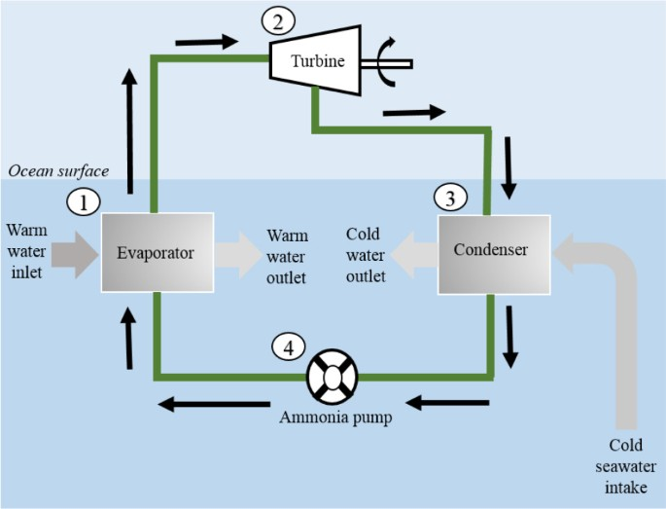
Construction
Turbine: Converts Heat Energy to Electric Energy
Evaporator: Vaporizes fluid using warm ocean currents
Condenser: Recycles fluid after heat extraction

Slide 4
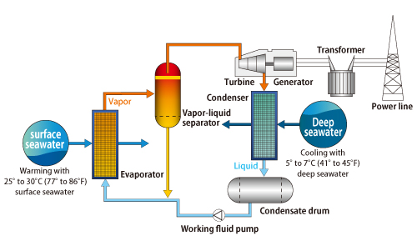
Working
Energy from the sun heats the surface water of the ocean. This creates a temperature difference between surface and interior. This temperature difference (of at least 77° Fahrenheit) is used to power a turbine to produce electricity.
Warm surface water is pumped through an evaporator containing a working fluid. The vaporized fluid drives a turbine/generator. The vaporized fluid is turned back to a liquid in a condenser cooled with cold ocean water pumped from deeper in the ocean

Slide 5
Applications
Electricity Generation
It can be used to produce electricity.
To desalinate ocean water. OTEC systems using seawater as the working fluid can use the condensed water to produce desalinated water.

